Slide 1
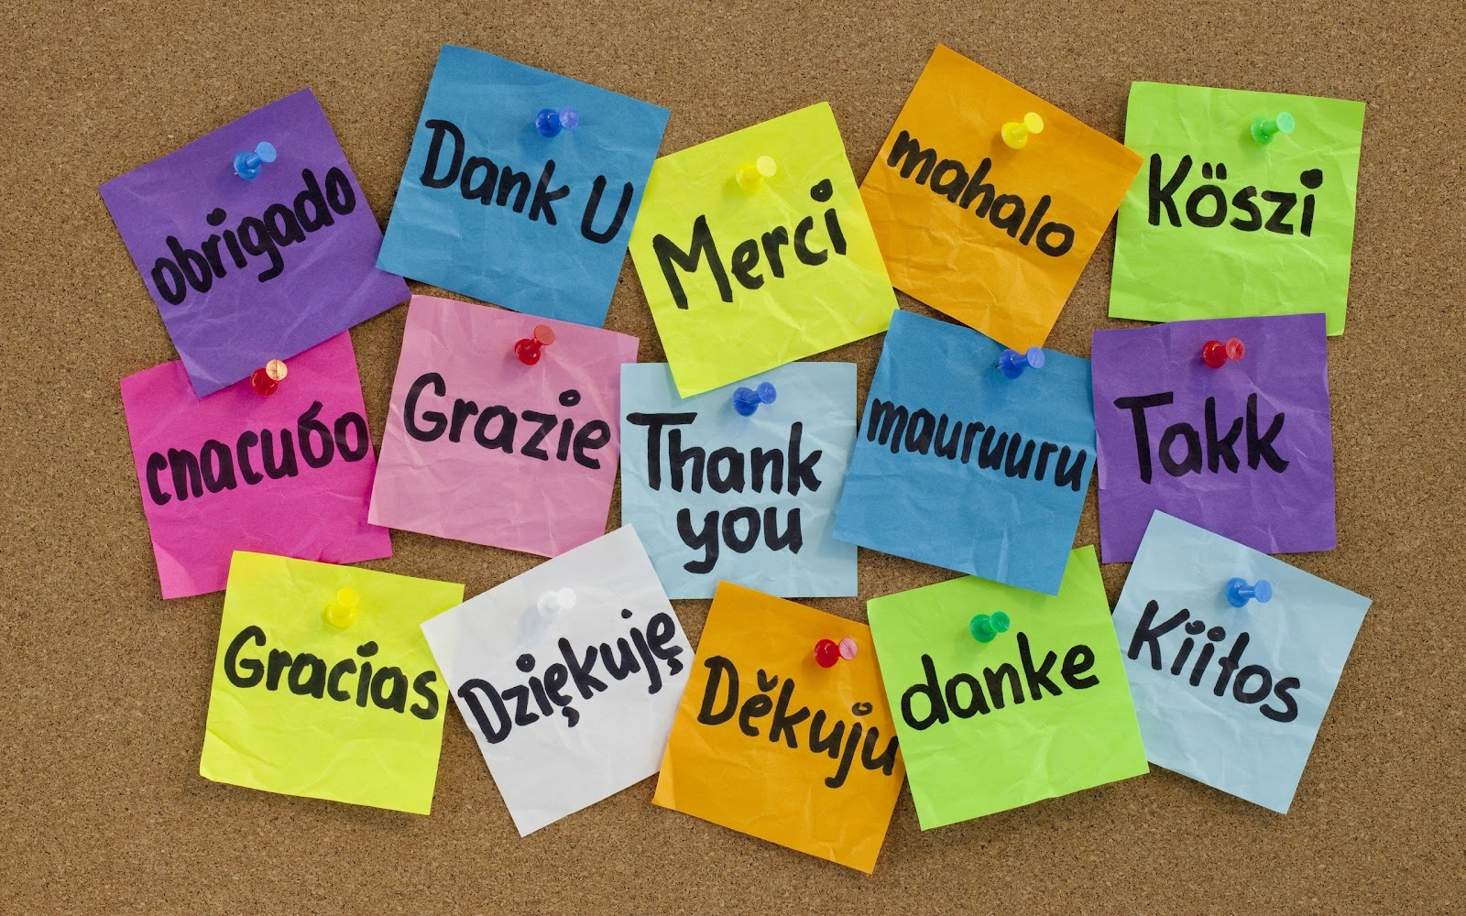
Notes:
Thank You:
Veterans
Our engineers
Our mentors and DevOps guides
The universe

Slide 2
The first 500 servers: Our DevOpsish* journey at a Microsoft Enterprise
Notes:
Not a paid professional speaker
Microsoft DevOps is under-represented
Give back
Role Model Growth Mindset

Slide 3
Etsy Day One Deploy
https://codeascraft.com/2012/03/13/making-it-virtually-easy-to-deploy-on-day-one/
Notes:
Wedding Desert
Real-time, shared console for automation
Public
More excited by ChatOps than anything in the last 20 years
“At Etsy we have one hard and fast rule for new Engineers on their first day: deploy to production. We’ve talked a lot in the past about our deployment, metrics, and testing processes. But how does the development environment facilitate someone coming in on day one and contributing something that takes them through the steps of committing code, running it through our tests, and deploying it with deployinator?”
I like this practice as it is aspirational and ensures that we are actively reducing friction for new hires (as well as for folks in other teams). In addition, it is super inviting to a new hire to jump in and start contributing within the first few hours.
Our last 3 new hires have committed “hello world” on Day 1 which I’ll now share (but not Kelsey Hightower style)

Slide 4
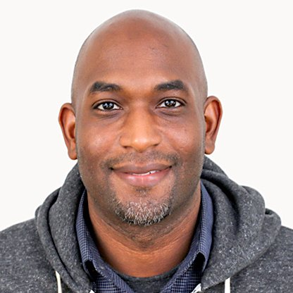
Live demos are awesome

Slide 5
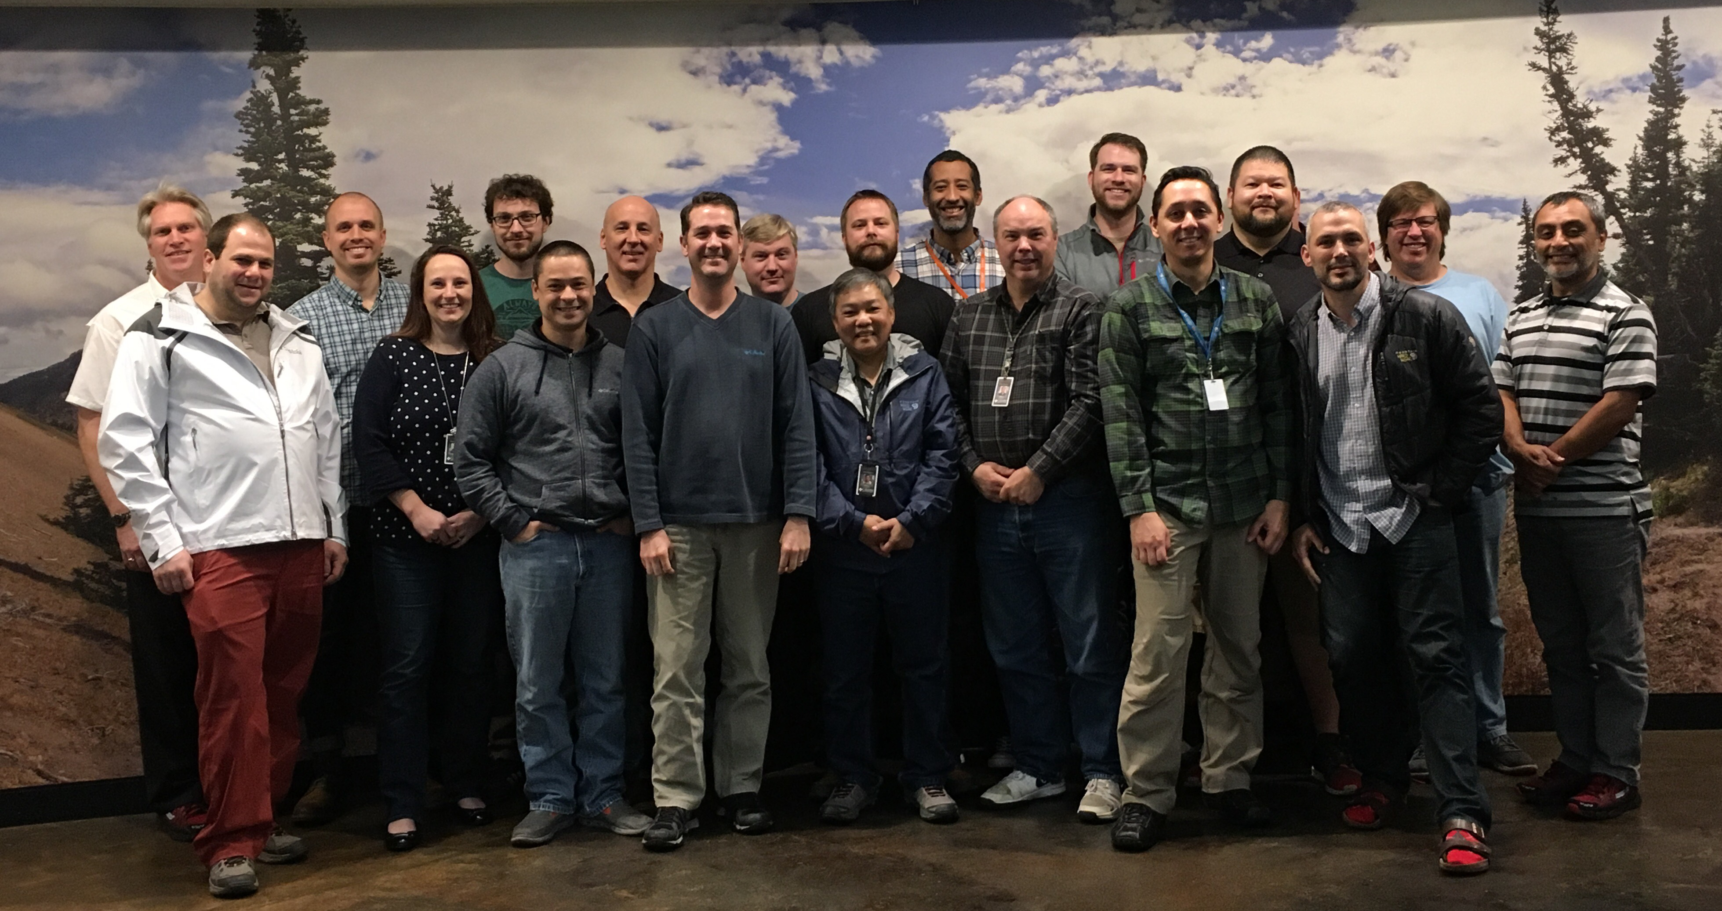
Team Photo
Notes:
Scott Nasello – Lead Platforms Engineering at Columbia Sportswear
Lucky to be along for the ride + Full Potential
Generally pleasantly surprised almost everyday
1) Highly experienced sysadmin/engineering team
2) 99% Vmware, 99% Microsoft Server, 3000 Servers
3) A few hundred off the shelf 3 tier business applications that were not architected for DevOps

Slide 6
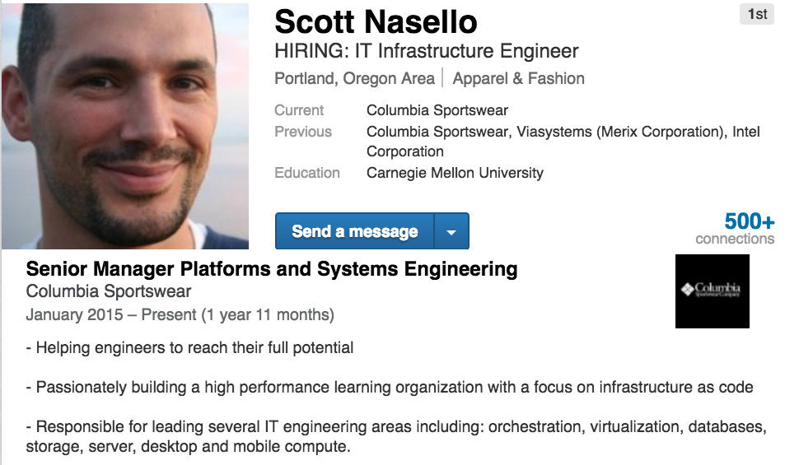

Slide 7
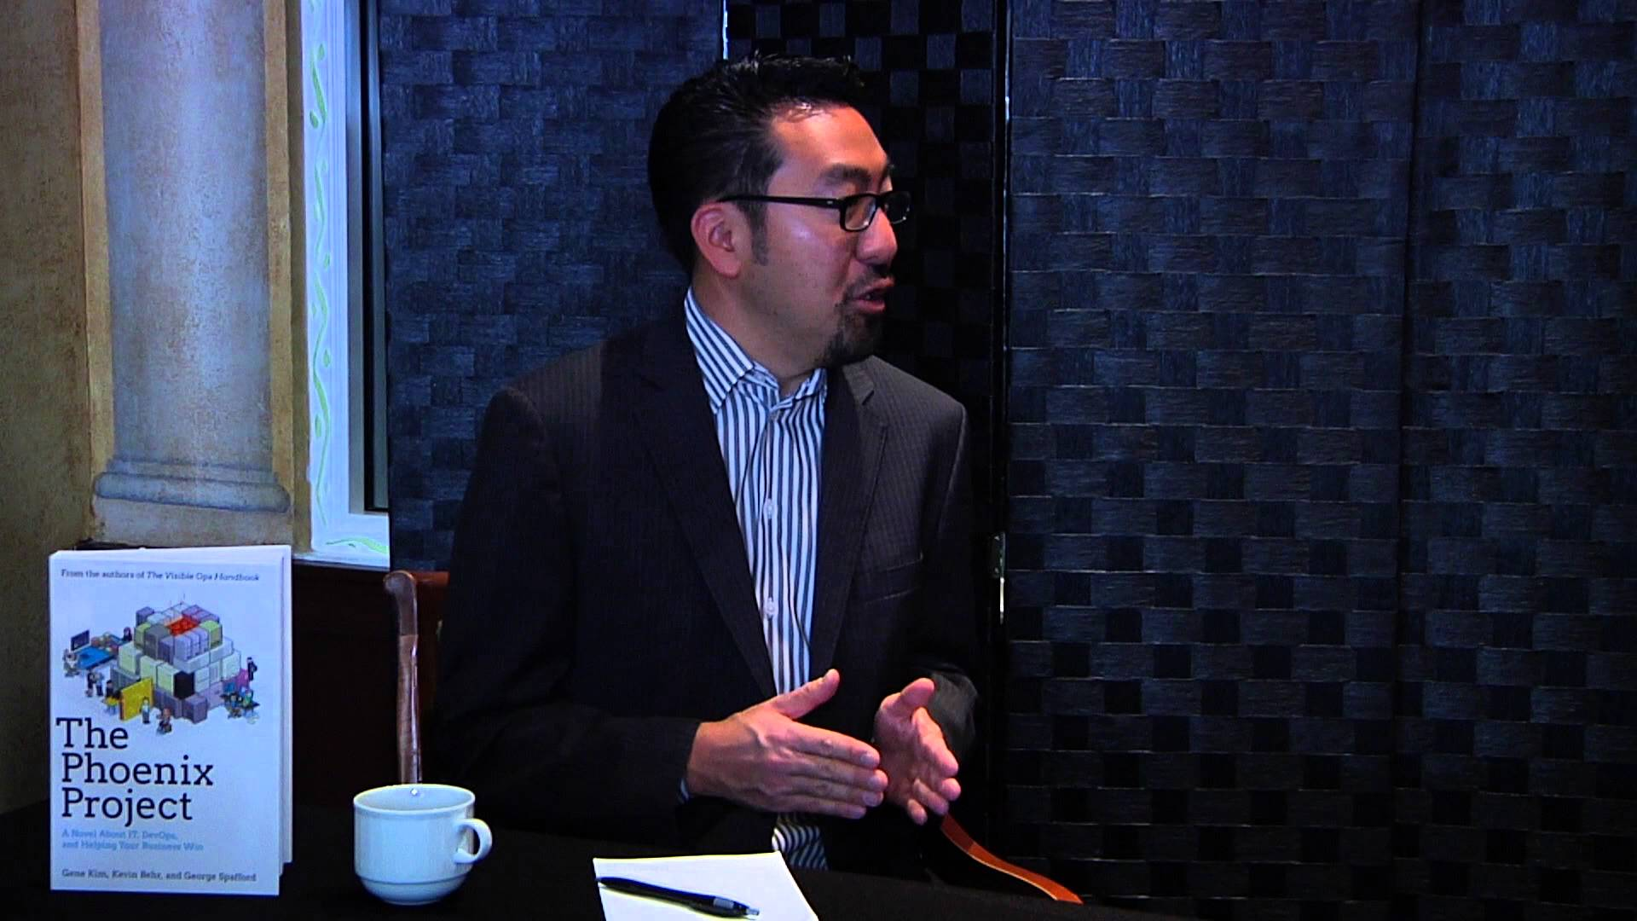
Gene Kim: A Study of High Performing IT Organizations
Notes:
Last minute sub for Gene Kim Talk
NEO from Matrix
Starting talking to peers about DevOps

Slide 8
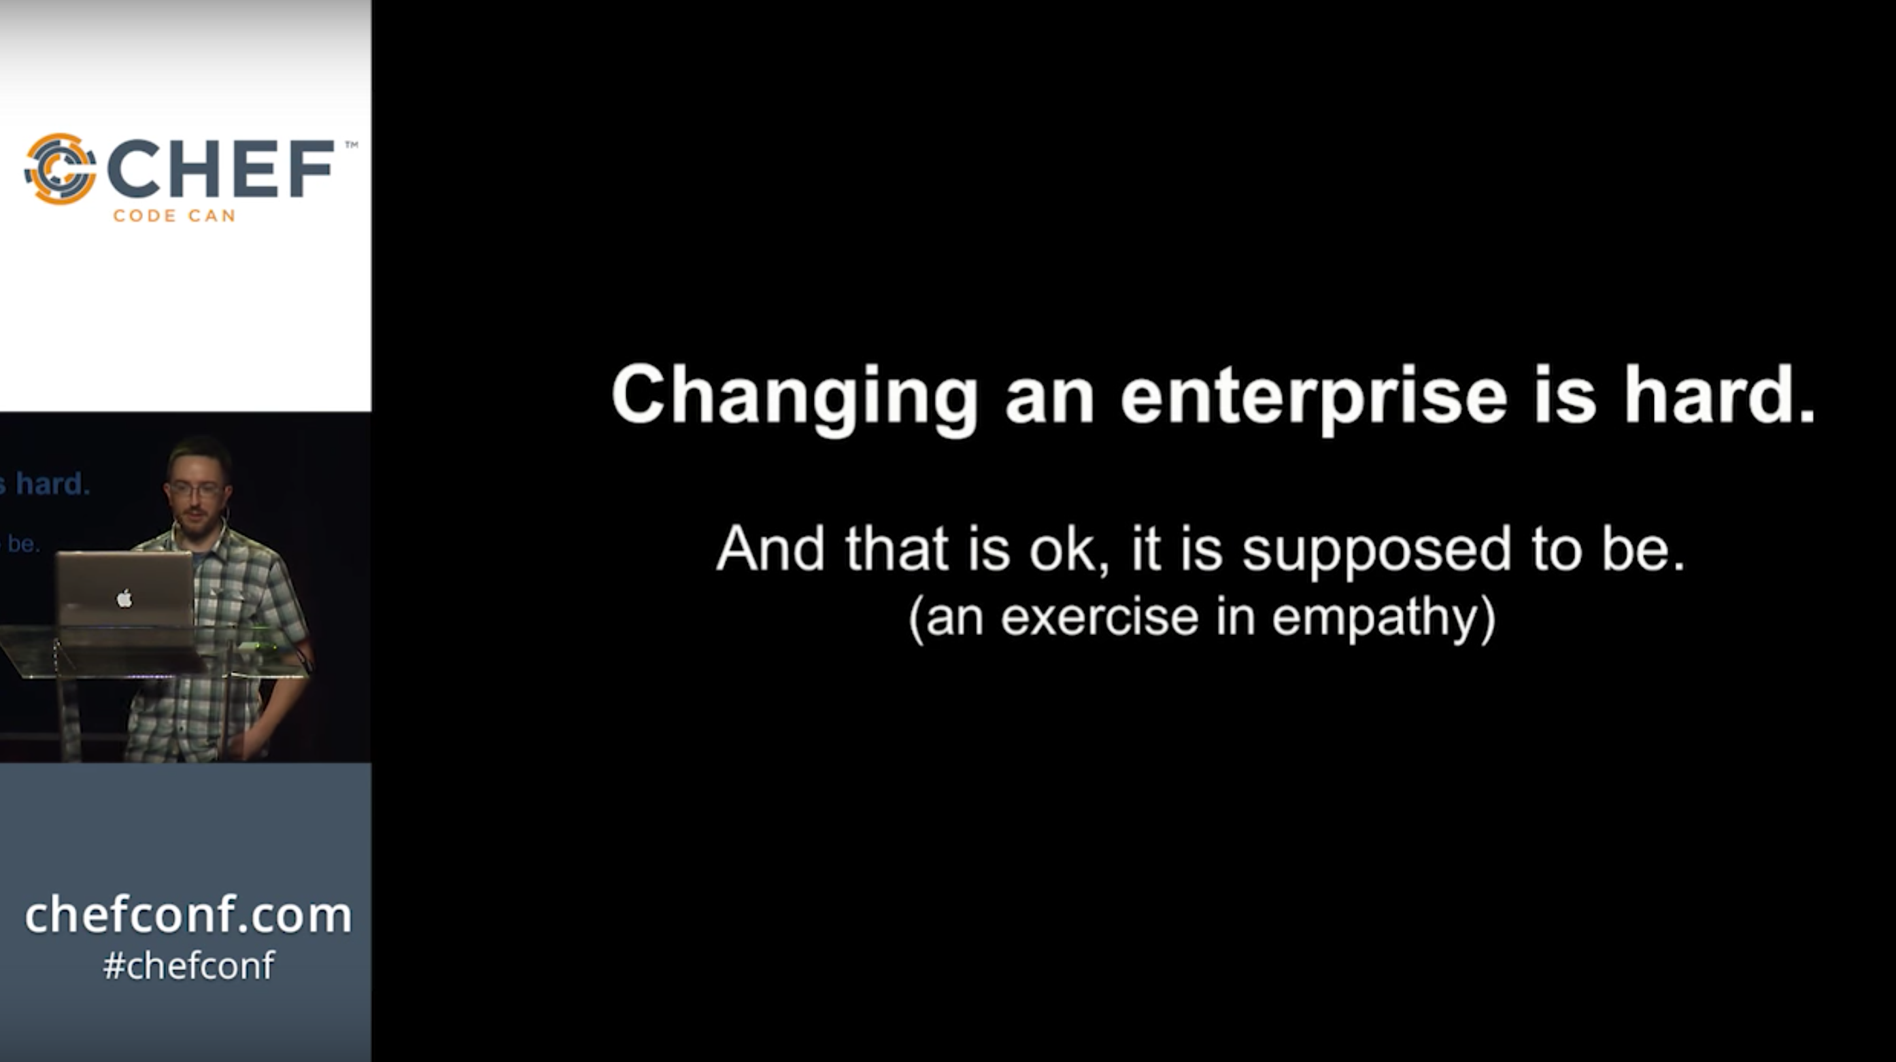
Rob Cummings, ChefConf 2014: DevOps Roller Coaster
Notes:
DevOps ambassadors
Optimized for incremental change
Small wins accumulate
Find mentors

Slide 9

The NEXT button is a fast-track to IT Pro irrelevancy. Become a Differentiated IT Pro by using automation
If the only admin value you add is the ability to click next, things are going to get tough
When you click a GUI – you have nothing to share. Powershell creates artifacts which enables a community of sharing
Jeffrey Snover
The secret is that the best engineers are lazy. They love automation & will spend days to automate something
If you want to be done with learning, get into forestry. If you are in IT, you are riding the tiger and it is constant renewal
Notes:
Jeffrey Snover: Tough love & Credibility
Engineer Whisperer
So your job is going to change, why not try DevOps?
Win-Win…good for the business and good for the employee

Slide 10
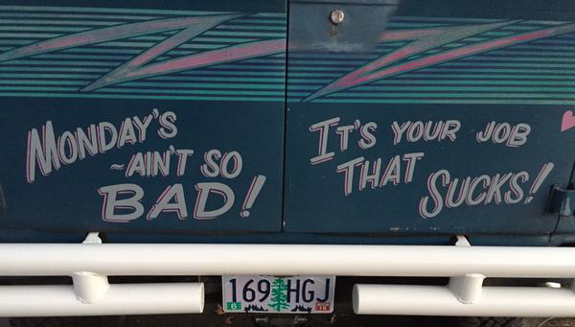

Slide 11
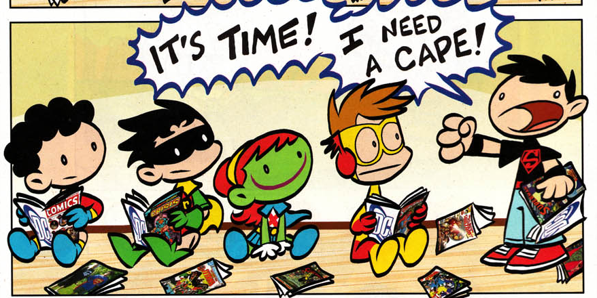
#LeaveNoEngineerBehind
Notes:
Understand each member of the team
Empathy for the journey you are prescribing
Calibrated expectations…one size does not fit all
#LeaveNoEngineerBehind

Slide 12
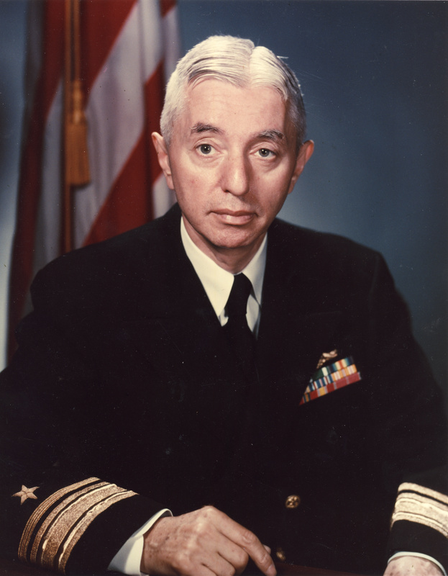
Good ideas are not adopted automatically.
They must be driven into practice with courageous impatience.
(Hyman Rickover)
Notes:
Bedside manner
Objections = engagement
Leadership will be lonely
Being right is not enough. Your bedside manner, your ability to communicate with patience and empathy will make a large difference. You should expect to receive a number of valid objections from the team. The good news is that the team is starting to understand/appreciate your vision when you hear things like:
“We are not like Flickr | Amazon | Netflix | Etsy”
“Why would we even want to deploy _____ servers in a day?”
“Wait, what? They have a SSH/RDP tip jar?”
“We don’t need______I can already do all that with Windows…”
“We don’t have time to make things better… “
“Wait, what? They rebuild a server if someone SSH into it?”
I take all of this an opportunity to continue the conversation and help them to work though the transition from a “Click Click Next Admin”.

Slide 13
Minimum Viable Process
Notes:
Monolithic tool familiarity
Simplifying new process and toolchains
You want others to join your cause don’t you? (Posh Origin)
Adam Jacob : “In the beginning you don’t have a scalability problem…you have an adoption problem”
Microsoft IT Pros are accustomed to monolithic tools versus the loosely coupled toolchains that are so common within the DevOps realm. What are you doing to make your processes as easy to adopt as possible for existing team members or new hires? It will be tempting to build the thing on the right but this will just be confusing and frustrating to the team. Your leads team should continuously ask themselves how are we reducing friction and making it easier to participate. This is an especially important idea when you start to collaborate with adjacent teams in new patterns….You do want them to join forces with you don’t you? As an example, we built a provisioning engine modeled after terraform for our on premise Vmware environement called PoshOrigin. The original design called for substantial dynamic inheritance and runtime intrpretation. As a leader I asked the team to refactor and to remove the dynamic portions as I felt these patterns would not be inviting to people not coming from a development background.
As the team becomes more comfortable, you can increase complexity if required.
Be open to letting the team define the processes they believe will generate the desired outcomes.
Be open to small scale experiments that can be expanded to the rest of the team if the results appear to be favorable. As proven by the mythbusters, small scale can increase intution and cheaply validate your ideas.
A comment by Adam Jacob from ChefConf 2015 has always stuck with me… ”In the beginning you don’t have a scalability problem…you have an adoption problem”

Slide 14
Version Control Everything
Puppet Labs, State of DevOps Report 2014
Notes:
One of 5 most impactful characteristics
Microsoft TFS because it was already in use
Goal of 250 artifacts by year end…actually over 600
Team recently moved to GitLab for less friction
Understanding our organization and the ability to absorb change, we focused on getting artifacts into version control
Version control was used as a gateway activity to introduce other ideas
During 2015 we went from Zero to 500 artifacts in version control
We had automated scripts that anyone could run to track progress against our goal of 250 production artifacts
We started in Microsoft TFS as it was already available and there was some expertise in the company. By the end of the year we moved to gitlab to reduce friction.
Peer-reviewed change approval process. We found that when external approval (e.g., change approval boards) was required in order to deploy to production, IT performance decreased. But when the technical team held itself accountable for the quality of its code through peer review, performance increased. Surprisingly, the use of external change approval processes had no impact on restore times, and had only a negligible effect on reducing failed changes. In other words, external change approval boards had a big negative impact on throughput, with negligible impact on stability.
Version control for all production artifacts. Version control provides a single source of truth for all changes. That means when a change fails, it’s easy to pinpoint the cause of failure and roll back to the last good state, reducing the time to recover. Version control also promotes greater collaboration between teams. The benefits of version control shouldn’t be limited to application code; in fact, our analysis shows that organizations using version control for both system and application configurations have higher IT performance.
Proactive monitoring. Teams that practice proactive monitoring are able to diagnose and solve problems faster, and have a high degree of accountability. When failures are primarily reported by an external source, such as the network operations center (NOC) — or worse, by customers — IT performance suffers.
High-trust organizational culture. One of the pillars of DevOps is culture, and we were pleased to prove what we already knew anecdotally: Culture matters. In fact, organizational culture was highly predictive of both IT performance and overall organizational performance. No one should be surprised to hear that high-trust cultures lead to greater performance, while bureaucratic and fear-based cultures are destructive to performance.
Win-win relationship between dev and ops. It’s not dev versus ops, it’s dev plus ops. When the outcome of a dev and ops interaction is win-win, IT performance wins.

Slide 15
Visualize Work : Kanban
Notes:
Expose the work
Create transparency
Minimize WIP/Task switching
Automation to make it easier such as continuous weeklong sprints
Daily/Weekly Kanban reports
Gentle pressure, team norming
Measure critical activities so you can adjust as needed

Slide 16
3 Tier Business App
DSC Server Provisioning | 60 Servers in 6 Env. | Bootstrap Chef
Install : Ant | Apache | Eclipse | Firefox | Java | Tomcat | SQL Server
Notes:
Collaborative win between Infrastructure & Applications Team
App team needed to upgrade their applications
Change engineers midstream
Freeze Meetings

Slide 17
Scaling
Notes:
Our server provisioning process uses Infrastructure as code (Terraform + DSC)
We bootstrapped CHEF during this process
Reverse engineer brownfield by auto generating files based on vSphere
Wrapper process to be able to consume existing PowerShell scripting
Pipelines reduce dependencies…more leverage

Slide 18
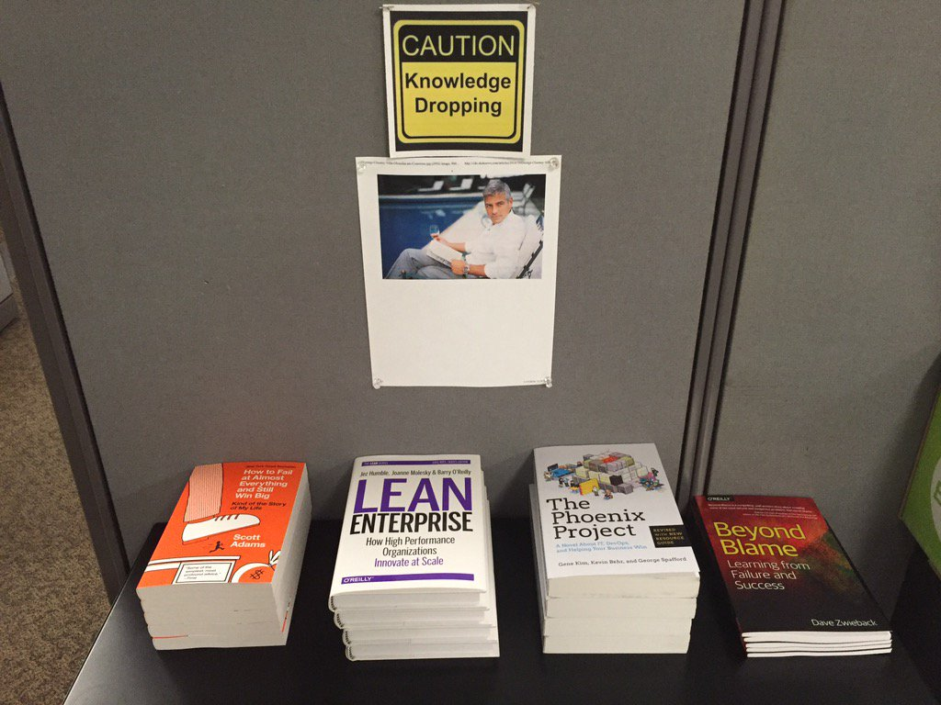
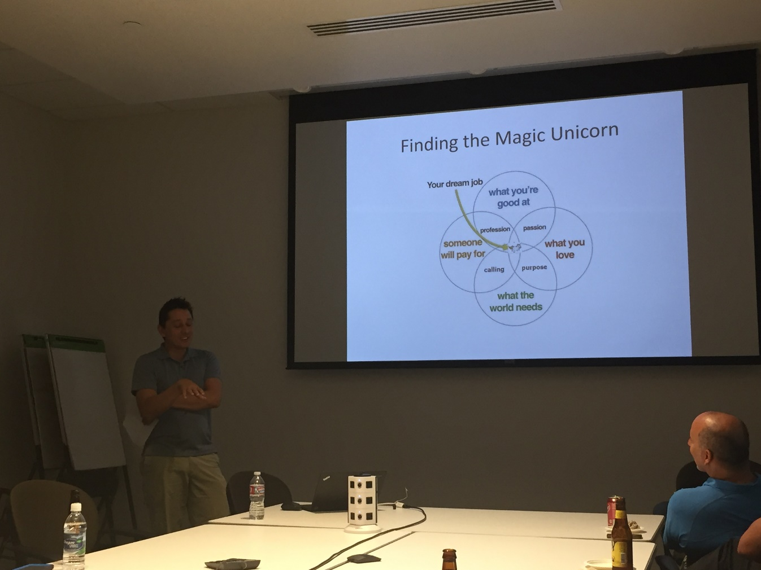
Building curious people
Notes:
Book Club
Podcast Club
Public speaking
Do engineers read? Not sure…We did put some books out to see what would happen (replenished a couple of times)
We’ve had 2 book clubs (facilitated by the team members) #1 – Beyond the Blame, #2 – How to Fail at Almost Everything and Still Win Big
We recently had a podcast club….My Year of Saying Yes, Surprising Habits of Creative People, How to Build a Better Job
We recognize that there are many distractions and we care less about how folks stay engaged

Slide 19
Hiring
Requirements
You are a collaborative team player with the ability to build high quality relationships
You are a curious engineer that is always learning and growing
You have experience in systems engineering
You are interested in Infrastructure as Code
Bachelor's degree or equivalent experience
3+ years of engineering experience
Bonus Points
Previous experience with Orchestration (CHEF, Puppet, Ansible, Salt, DSC, etc.)
Experience operating public cloud infrastructure (AWS, Azure, etc.)
Experience in multiple engineering disciplines (development, networking, storage, databases, applications)

Slide 20
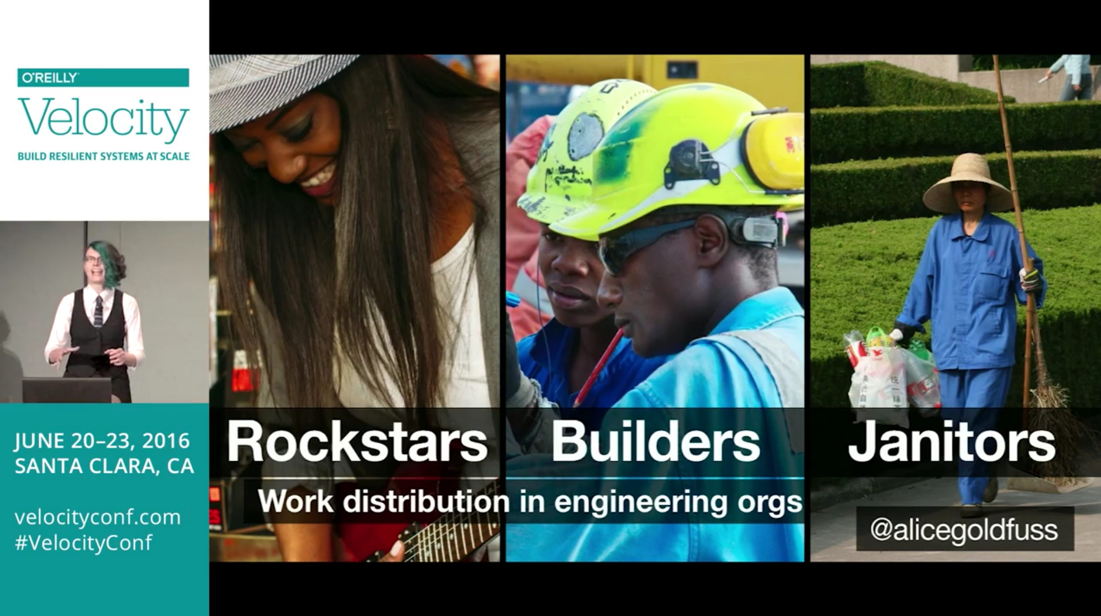
Notes:
Title
10/30/60
Rotations
Unexpected benefits: Gateway to experimentation, use incidents as cross training

Slide 21
Full-er Stack Team
Platform Eng Manager
Storage Engineer
2 x Database Engineer
2 x Virtualization Engineer
2 x Microsoft Engineer
Backup & Recovery Engineer
Collaboration Engineer
X 2

Slide 22
ChatOps all the things!
Client Mgmt | Active Directory | ChatOps Mgmt | Server Mgmt | CHEF | Kanban | Environment Mgmt | IT Service Mgmt | Backup & Recovery | Team Jukebox | Git Repo Mgmt | Retail Mgmt | AV | Load Balancing | Printers

Slide 23
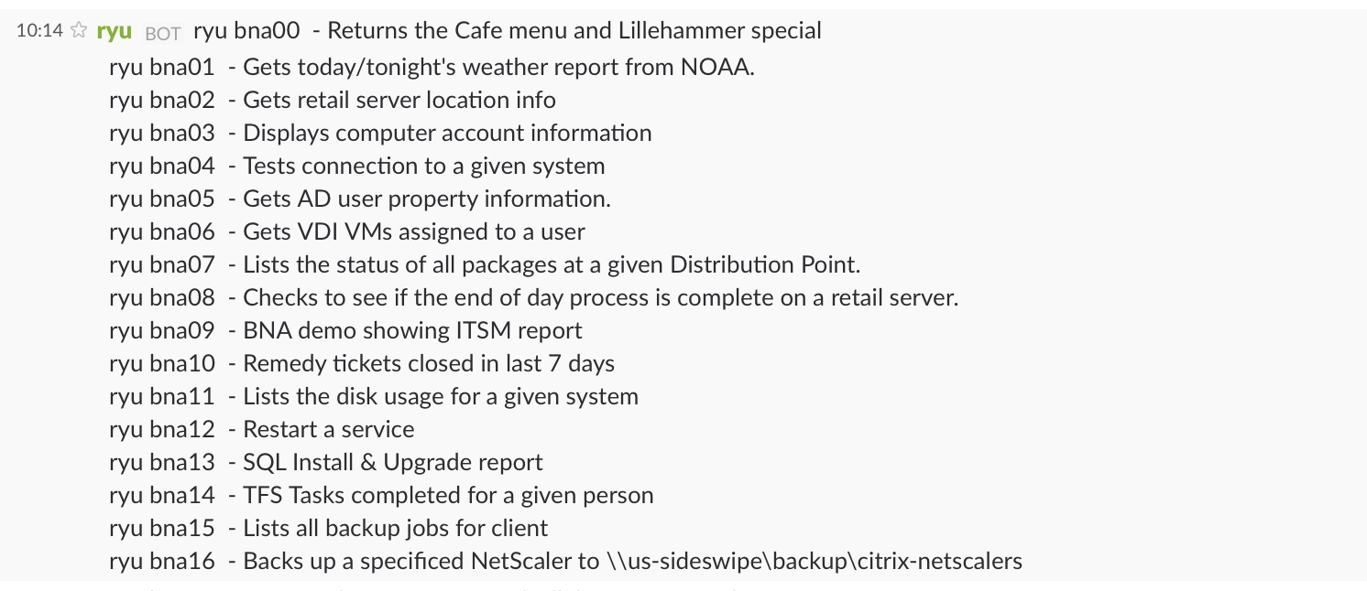

Slide 24
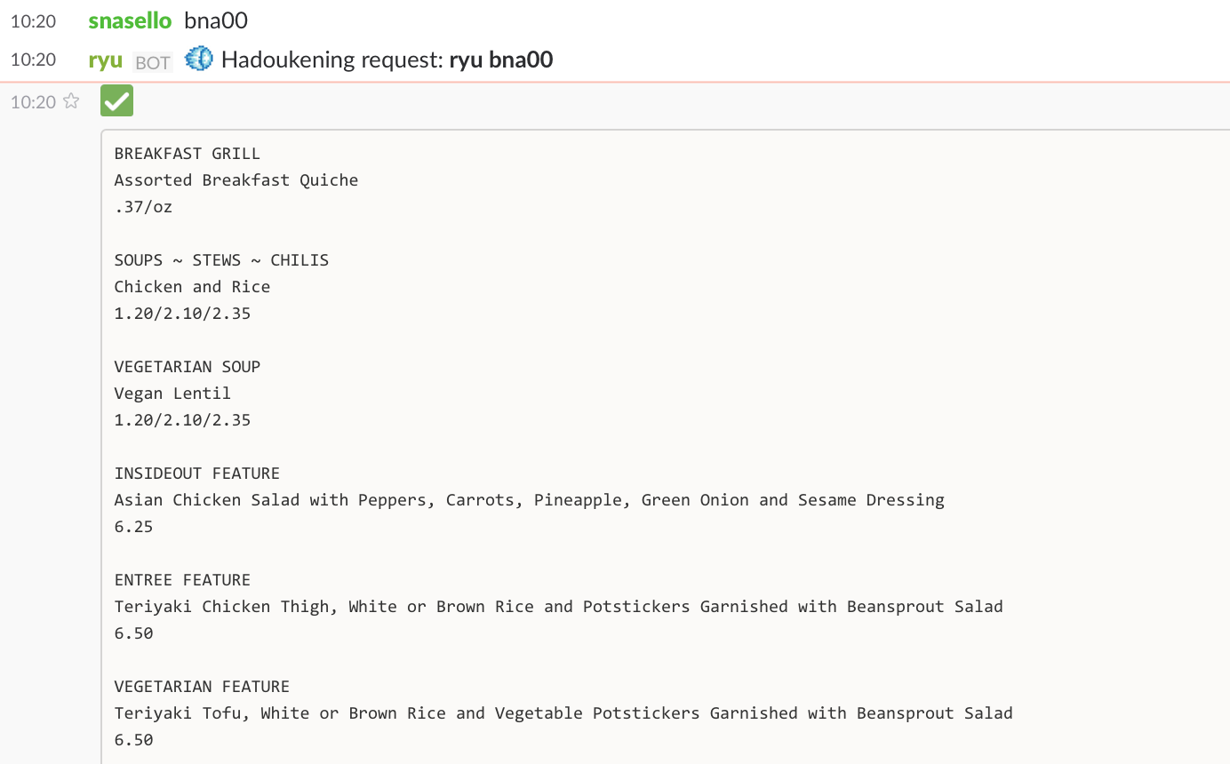

Slide 25
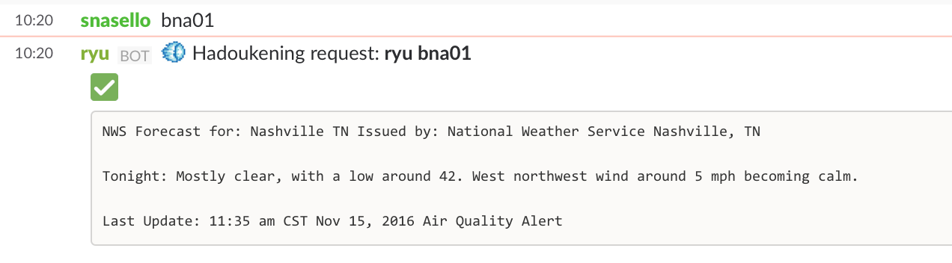
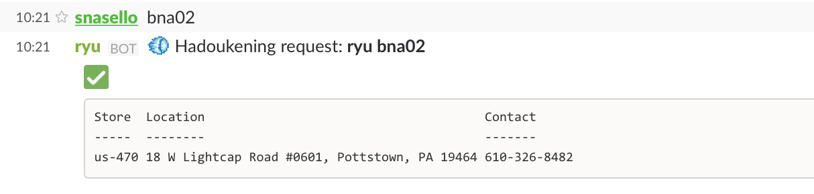

Slide 26
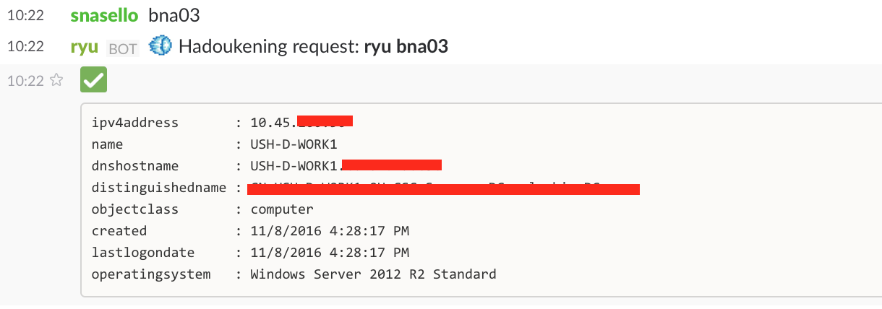
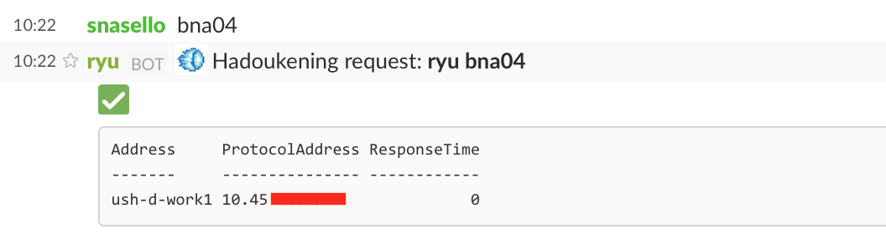

Slide 27
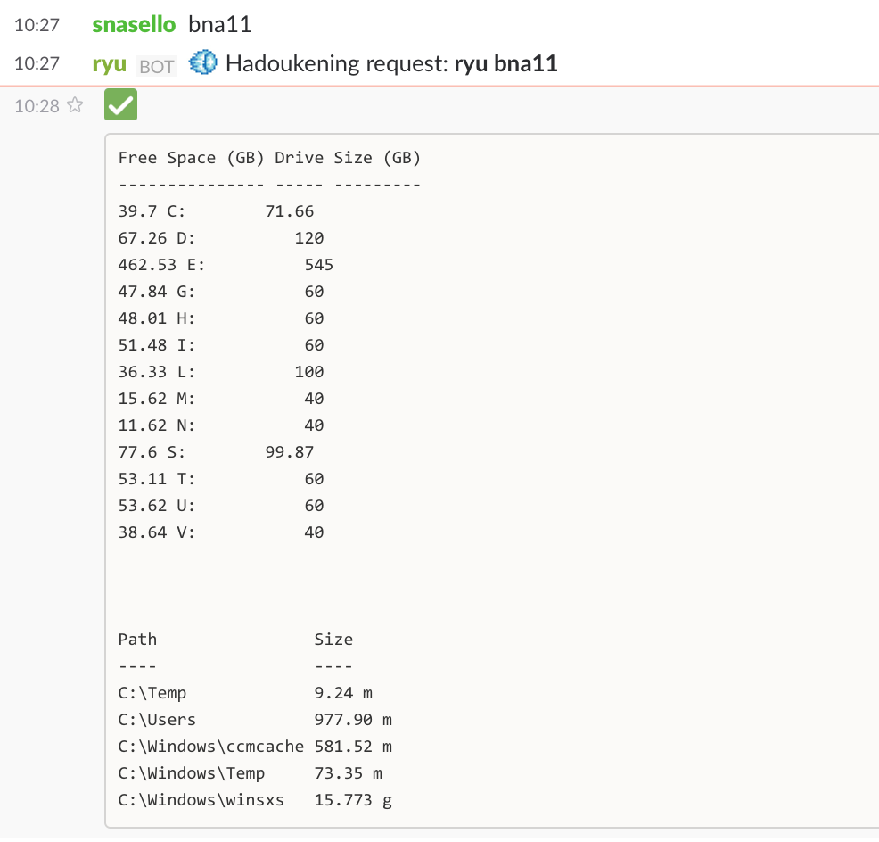

Slide 28
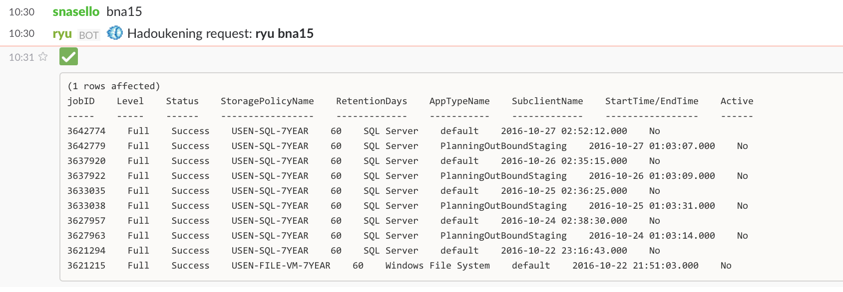

Slide 29
Notable Milestones
2/2015: Standups, TFS Kanban, TFS Version Control
9/2015: Server Provisioning via VMware PowerCLI
9/2015: 250 Artifacts in version control
2/2016: 3 Tier Business App Delivery
6/2016: Slack & Hubot for ChatOps
6/2016: Reorganization for “fuller stack” focus
7/2016: GitLab Version Control

Slide 30

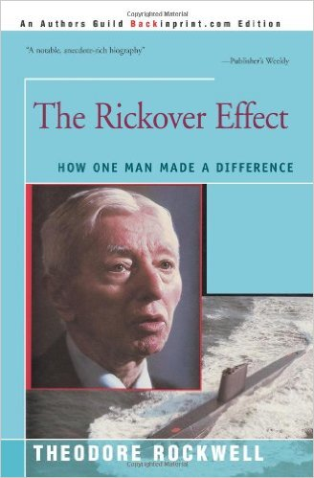
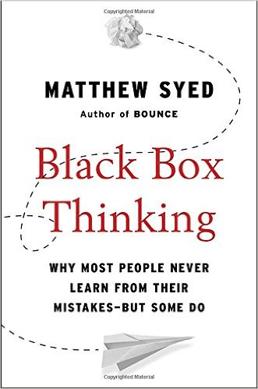
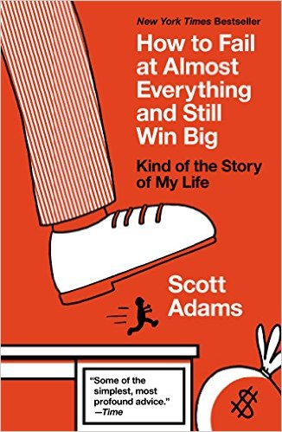
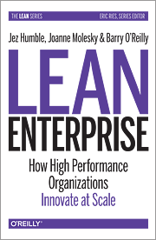
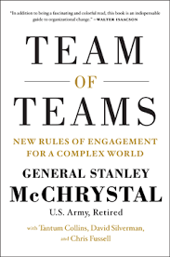

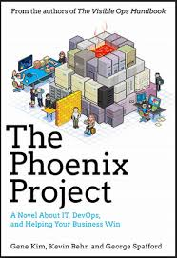
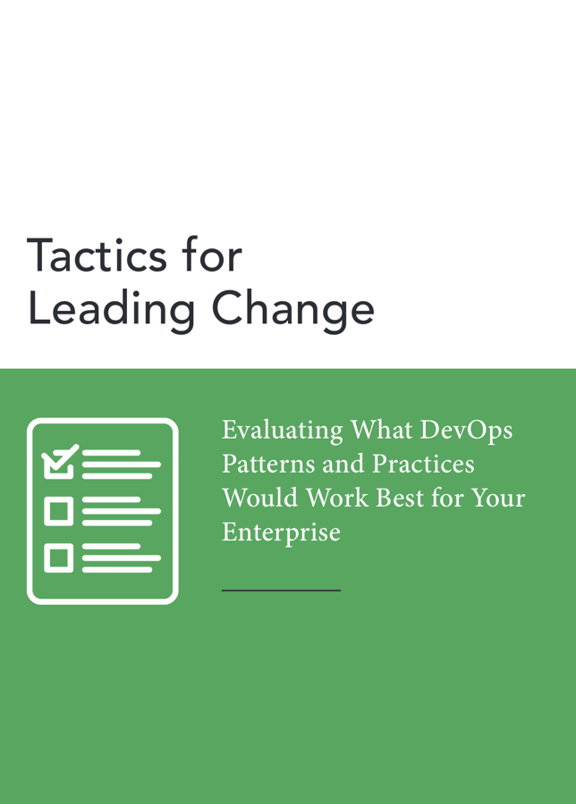
Thank You
Minimum Viable Process (apply PDSA! Plan-Do-Study-Act)
Find the win-win: good for the enterprise & good for team
Make it easy for new adopters to join

Slide 31
Timeline & Milestones - tl;dr
1/2014: SIM Portland – Gene Kim
10/2014: DevOps Enterprise Summit + CHEF intro
2/2015: Arrested DevOps #30
2/2015: Weekly Standups, TFS Kanban
3/2015: Primary & Alternate responsibility flip
3/2015: TFS Version Control
4/2015: ChefConf 2015 & Phoenix Project assigned
5/2015: Low WIP experiment
6/2015: Onsite CHEF training
9/2015: TFS PowerShell utilities & Sprint Automation
9/2015: Server Provisioning via VMware PowerCLI
9/2015: Provisioning Working Group
9/2015: 250 Artifacts in version control
9/2015: PowerShell onsite training
10/2015: First Server Environment w/PoshOrigin
10/2015: First 50 CHEF Nodes
11/2015: Prepare Workspace Module (TFS, Git, Chef Dk, etc.)
12/2015: Distribution of PowerShell Modules to Ops teams
1/2015: 150 CHEF Nodes
2/2016: 3 Tier Business App Delivery
5/2016: Artifactory for artifacts
6/2016: Velocity Conference
6/2016: Slack & Hubot for ChatOps
6/2016: Reorganization for “fuller stack” focus
6/2016: Data Center move Stretched vSAN & Automation
7/2016: GitLab Version Control
8/2016: Collapse ITSM Queues
9/2016: ~5 new ChatOps scripts committed per week
9/2016: Rockstars, Builders, Janitors Experiments
10/2016: SAP non-prod refresh via ChatOps
10/2016: 100+ ChatOps scripts

